Slide 1
NYPD Shootings – Elevator Pitch
Week 4 Assignment
Introduction to Data Science

Slide 2
NYPD shooting data
The NYPD shooting data covers shootings in the five boroughs of NY, that may or may not have resulted in death of the victim, between the years 2006 and 2020
Geographical location; age, gender, and race info on the perpetrator and victim; time and date of occurrence are available in the data set.
Data source:
https://data.cityofnewyork.us/api/views/833y-fsy8/rows.csv?accessType=DOWNLOAD

Slide 3
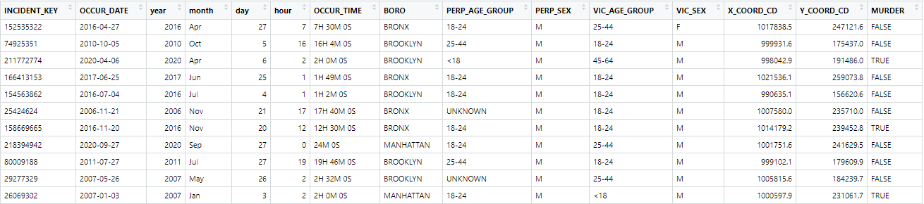
Tidy data set

Slide 4

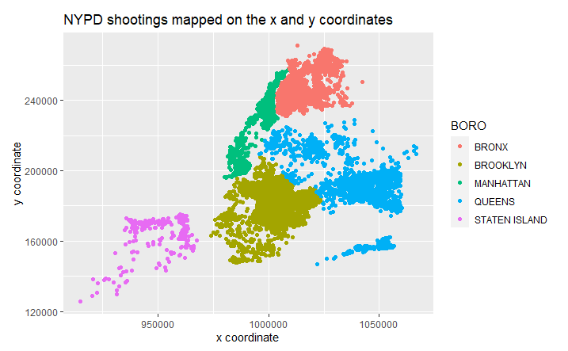
Visualize the data
Draw graphs to explore the relationships between the collected data points (that is, the variables)
Map source: map of new york state boroughs - Bing images

Slide 5
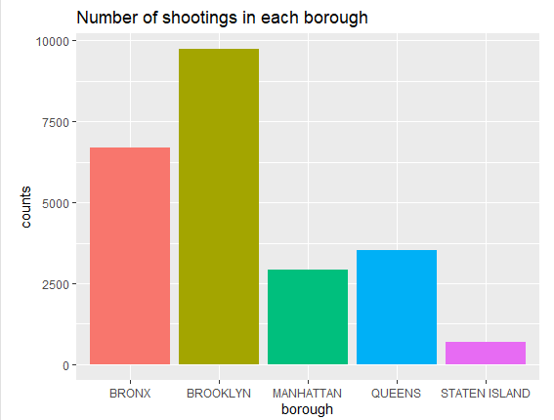

Slide 6
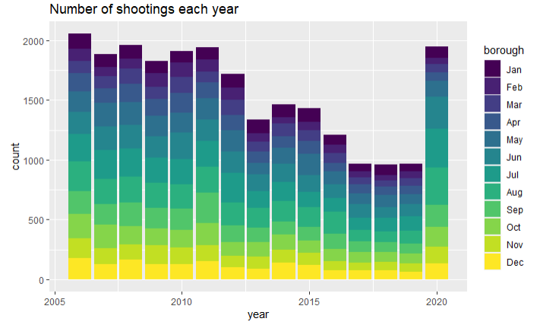

Slide 7
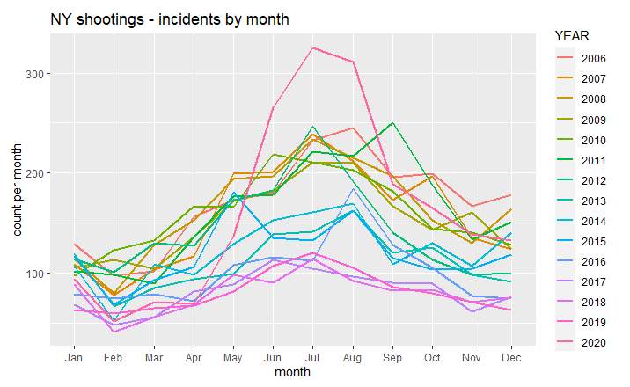

Slide 8
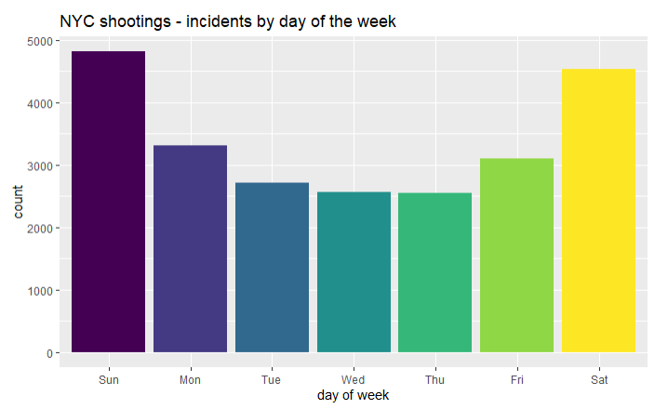

Slide 9
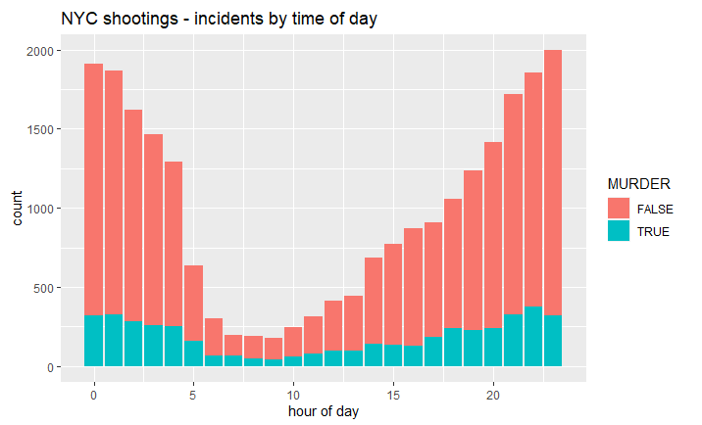

Slide 10
Summary
Brooklyn and Bronx have the highest number of shootings
Shootings decreased between 2006 and 2019, but increased in 2020
Shootings are more common in May to October, on Saturdays and Sundays and between the hours of 7 pm and 4 am

Slide 12
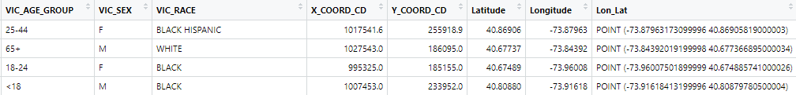
Information in the data set

Slide 13
Choose columns to analyze
Delete columns
Selected columns
JURISDICTION_CODE
PRECINCT
LOCATION_DESC
PERP_RACE
VIC_RACE
Latitude:Lon_Lat
INCIDENT_KEY
OCCUR_DATE
OCCUR_TIME
BORO
STATISTICAL_MURDER_FLAG
PERP_AGE_GROUP
PERP_SEX
VIC_AGE_GROUP
VIC_SEX

Slide 14
Tidy the values in the columns
Change the values in the columns so that they are of the correct type
e.g.: date should be recognized as a date and not a sequence of characters
Add new columns with additional values
e.g.: add a new column for ‘year’
Rename columns
e.g.: ‘STATISTICAL_MURDER_FLAG’ renamed to ‘MURDER’

